Slide 1
Chapter 18-Selective Repeat ARQ

Slide 2
Introduction
Go-Back-N always discards out-of-order frames
  Losing one frame may result in retransmission of multiple frames
  Very inefficient in noisy link
  In a noisy link a frame has a higher probability of damage; which means the resending of multiple frames.
  This resending uses up the bandwidth and slows down the transmission.
Selective Repeat ARQ does not resend N frames when just one frame is damaged, only the damaged frame is resent.
Selective Repeat ARQ allows frames to be received out of order
  Therefore, receive window > 1

Slide 3
Introduction
Sender and receiver share window space equally
It defines a negative ACK (NAK) to report the sequence number of a damaged frame before the timer expires.
For m-bit sequence numbers
  Send window: up to 2^{m-1}
  Receive window: up to 2^{m-1}

Slide 4
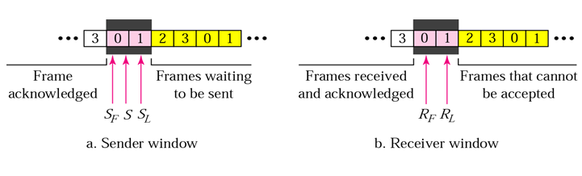
Sender and Receiver window
The configuration of the sender and its control variables for Selective Repeat ARQ is the same as those for Go-Back-N ARQ.
However, the size of the window should be at most one-half of the value 2^{m}.
The receiver window size must also be same size.
Receiver window specifies the range of the accepted received frame.

Slide 5
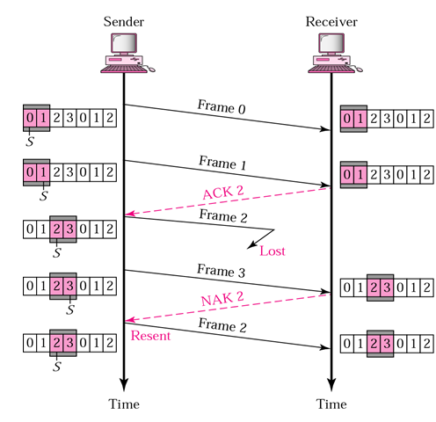
Selective Repeat ARQ-Lost Frame
Frames 0 and 1 are accepted when received because they are in the range specified by the receiver window. Same for frame 3.
Receiver sends a NAK2 to show that frame 2 has not been received and then sender resends only frame 2 and it is accepted as it is in the range of the window.

Slide 6
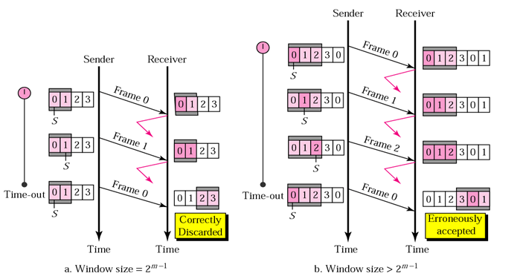
Selective Repeat ARQ- Sender Window Size
Size of the sender and receiver windows must be at most one-half of 2 ^{m}. If m = 2, window size should be 2 ^{m} /2 = 2. Fig compares a window size of 2 with a window size of 3. Window size is 3 and all ACKs are lost, sender sends duplicate of frame 0, window of the receiver expect to receive frame 0 (part of the window), so accepts frame 0, as the 1st frame of the next cycle – an error.

Slide 7
Selective Repeat ARQ- Sender Window Size

Slide 8
Piggybacking
The three protocols we discussed are all unidirectional: data frames flow in only one direction although control information such as ACK and NAK frames can travel in the other direction. In real life, data frames are normally flowing in both directions: from node A to node B and from node B to node A. This means that the control information also needs to flow in both directions. A technique called piggybacking is used to improve the efficiency of the bidirectional protocols. When a frame is carrying data from A to B, it can also carry control information about arrived (or lost) frames from B; when a frame is carrying data from B to A, it can also carry control information about the arrived (or lost) frames from A.

Slide 9
Problem
Explain how a lost frame is handled using Selective Repeat ARQ.
For a system using Selective Repeat ARQ, explain why the size of the sender and receiver windows must be at most one-half of 2 ^{m} , where m is the number of bits for the sequence number.
Problem

